Slide 1
READING

Slide 2
Please do not focus on memorizing the week’s story!
Instead practice the week's focus skill. Help your child to read different texts and think about their meaning and purpose.

Slide 3
Different kinds of texts, WHAT?!
I mean read anything you can with your child: recipes, labels, instructions, magazines, newspapers, web articles- (help children to learn safe internet browsing and how to tell what is factual and what is not), books, billboards, signs, etc.
That means you can read to them and with them all the time! (Your child can read to you while you are cooking, they can read to a brother or sister…)
Read out loud to them- think about your reading "out loud" to them and ask them to do the same for you.

Slide 4
Homework
We ask students to read ALOUD for 20 minutes each night.
Please review their vocabulary words, focus skills, and story with them throughout the week.
Occasionally, they will need to finish classwork, other homework or have a study guide to complete.
We have had issues in the past with students taking their incomplete classwork out of their binder and leaving it at home. Please make sure your child brings it back completed the following school day! We may take it for a grade.

Slide 5
Weekly Tests
Students will be tested weekly on their vocabulary and focus skills.
They will not be tested on the week’s story.
Vocabulary- They will have to use the word correctly in a sentence.
Focus Skill- They will read a passage for the first time (We call this a “cold read”) and answer questions to the passage based on the week’s focus skills.
See example:

Slide 6
Grades
Classwork and homework count for 25% of their final grade
75% of their final grade will come from tests.

Slide 7
Handwriting
This is huge!! By third grade we expect students to know the difference in neat and sloppy handwriting.
We will begin working on cursive this year, therefore the students should be able to write in print.
Please remind them of appropriate areas to use capital letters and to check the b’s and d’s.

Slide 8
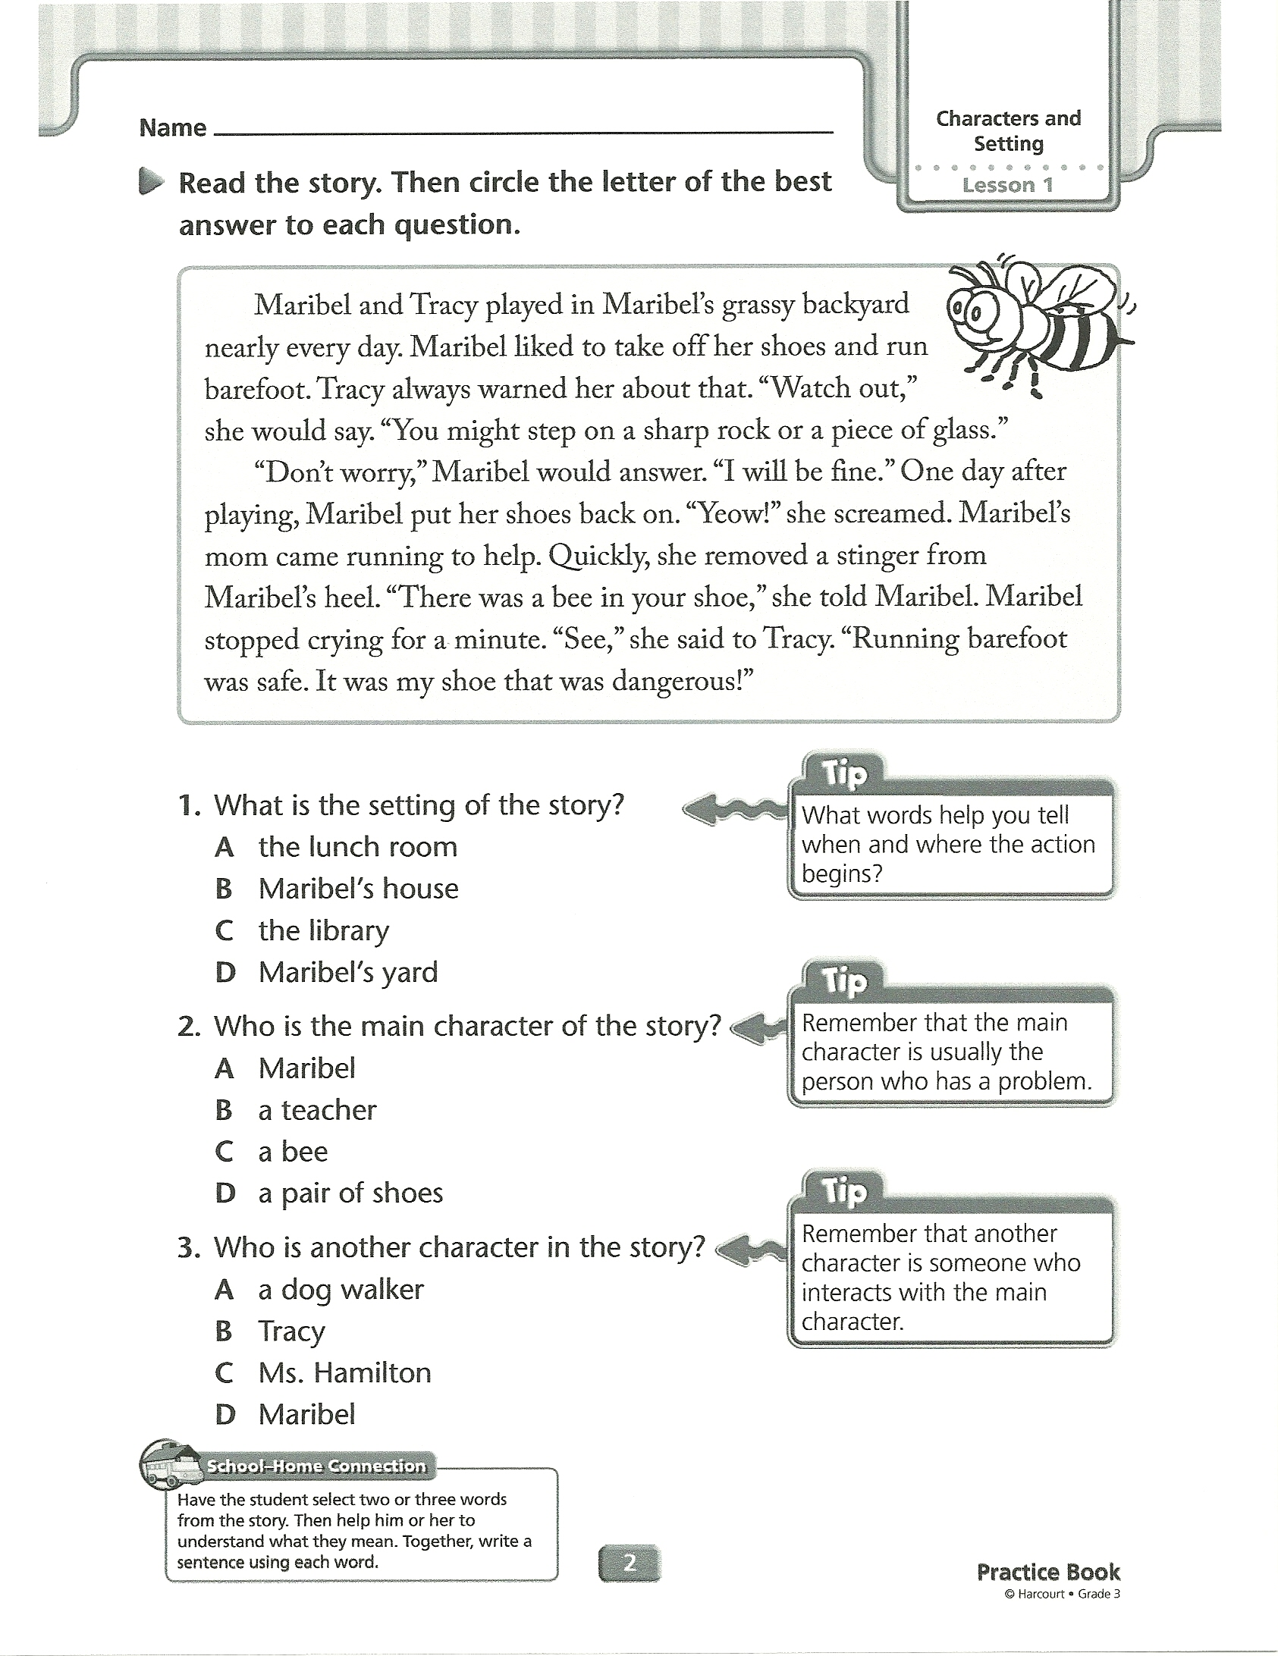
Characters and Setting
Focus Skill

Slide 9
HELPPPPPPPP!
If your child is struggling in any area in reading, please stay in contact with your child’s teacher and work with her to help your child improve.
A child is more successful in school when the teacher and parents are working together to help the child succeed.☺

Slide 10
Websites Make Great Resources!
We have compiled a list of websites the students can get on here at school AND at home!
Capstone library www.mycapstonelibrary.com
Think Central www-k6.thinkcentral.com
Reading Eggs www.readingeggs.com

Slide 11
Most IMPORTANTLY
MAKE READING FUN and important to them and they will excel!

