Slide 1
ACT Aspire Test Preparation

Slide 2
What is the ACT Aspire and where can I go to learn more about it?
http://www.discoveractaspire.org/
ACT Aspire
Grades: Third Grade through Eighth Grade
ACT AspireTM is a computer-based, longitudinal assessment system that connects growth and progress from elementary grades through high school in the context of college and career readiness. Assessing students’ knowledge and skills is critical to ensuring all students receive the support and services necessary to help them succeed in school and life. The essential, actionable information and insights gained from ACT Aspire Assessment System® help educators understand a student’s past, capture the present, and impact the future.

Slide 3
What is ACT Aspire
ACT Aspire is an assessment system that measures academic achievement in different subject areas including Reading and Math in grades 3- 10.
The assessment will show a child’s strengths and weaknesses in specific skill areas to help students, parents and teachers determine where help is needed and where students should be challenged.

Slide 4
Why are students taking the ACT Aspire?
Research shows that the earlier we measure progress toward meeting educational standards, the more we can strengthen a student’s chances to stay on target to succeed, and, ultimately, be ready for college and work after high school.
With ACT Aspire, you can determine whether your child is meeting key benchmarks all along the way so necessary steps can be taken to keep him or her on track.

Slide 5
Our students will be taking the Reading and Math portions of the test. Here is
more information about each test.

Slide 8
So, what’s going to be on the test?
The ASPIRE is aligned with the Common Core standards.
http://www.thecurriculumcorner.com/thecurriculumcorner123/wp-content/pdf/ican/icanmonitorcheckboxes3cute.pdf
Math Common Core Flipbook
http://alex.state.al.us/ccrs/sites/alex.state.al.us.ccrs/files/Grade%203.pdf
Parent’s Guide to Student Success
http://jessicaweldon.weebly.com/3rd-grade-school-success.html

Slide 9
Links To Practice Tests!
What does the test look like?
http://www.rollingsmiddle.com/Sauer/ACT_Aspire_Practice.htm
http://www.mrscoggin.com/act-aspire-practice.html
Math Practice
http://www.discoveractaspire.org/uploads/2/4/0/7/24070377/act_aspire_math_exemplar.pdf
Reading Practice
http://www.discoveractaspire.org/uploads/2/4/0/7/24070377/act_aspire_reading_exemplar.pdf
More Practice
http://downloads.bbc.co.uk/skillswise/english/en14para/game/en14para-game-story-builder/story_builder.swf
http://mrnussbaum.com/langcode/
Go to Online Reading Comprehension exercises

Slide 10
Other things to note…
*Students have to be able to utilize a test booklet and an answer document. While they can write in the test booklet to work out their problems, they have to transfer their answer to their answer document. So we will be working with the students to learn how to do this.
*Teachers have strict testing instructions to which we must adhere. Teachers are not allowed to read anything to the students without special accommodations- Not even a word on a math problem.
Test Taking Strategies
http://jessicaweldon.weebly.com/actaspire.html

Slide 11
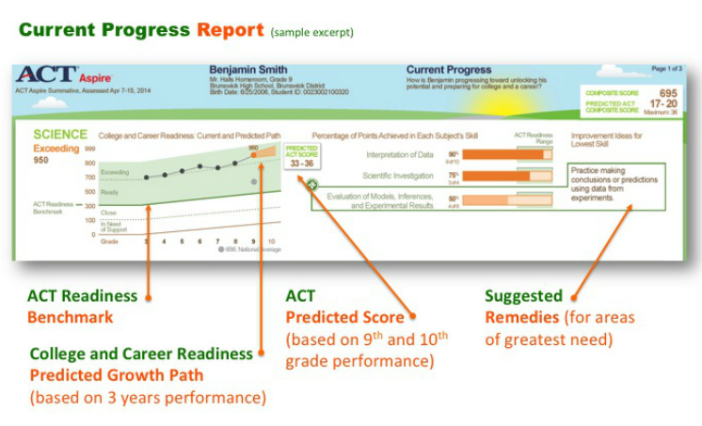
Example of a report

Slide 12
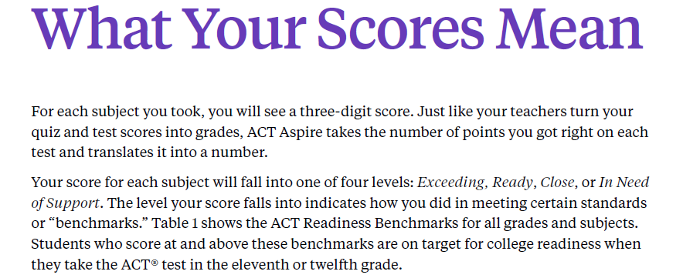
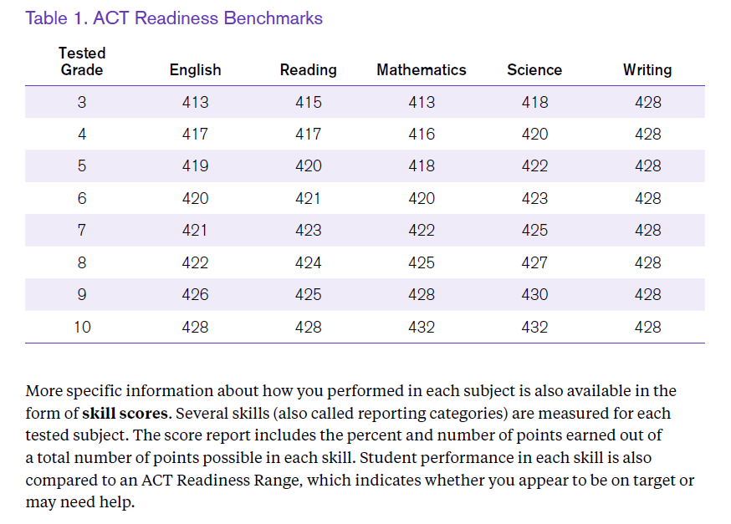

Slide 13
SO WHEN WILL IT BE?
The testing window will be in April.
Please make sure you child is here and well rested for all days of the test!

Slide 14
Please visit the ACT Aspire website for more information
Information and pictures from website
http://www.discoveractaspire.org/
Additional PowerPoint Presentation
http://assessment.aurorak12.org/wp-content/uploads/sites/5/2014/01/ACT-Aspire-Power-Point-3-14.pdf

